Slide 1

Data Analytics Pipeline for A-VIEW System
Ekalavya Summer Internship 2019
Mentor: Ms. Sukla Nag

Slide 2
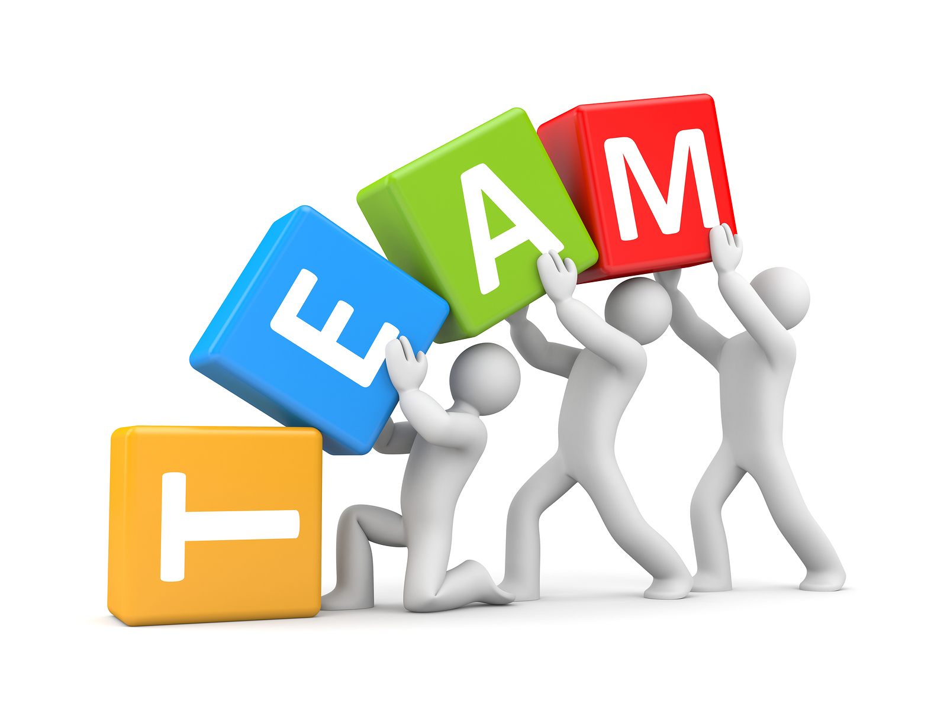
Sanskriti Agrawal
IIITDM Jabalpur
Ayush Agarwal
Amity University, Noida
Divyakumar Patel
GCET, Gujarat
Mayank Agarwal
PES University, Bengaluru
Sakshi Sharma
IIITDM Jabalpur

Slide 3
WHAT IS OUR PROJECT ABOUT?
Notes:
The project’s aim is to segregate operational non-operational queries. Operational queries are the ones which are regarding glitches in communication channel between student and instructor. An example would be “Video is not visible”, “Can you hear me!?” etc. Non-operational queries are the one’s regarding academic doubts.

Slide 4
WHY ARE WE DOING THIS ?
Notes:
Now, Why r we doing this? We are working on A-view videos and chat messages.A-view is a multi-platform e-learning solution which allows the instructor to interact with students through live audio videos. Segregating operational queries from these a-view videos and chats will help us to know which remote center is facing more system servicing problems and these can be rectified also non-operational will let us know on which subject student is facing difficulty. By improving the system connectivity the student can access the a-view videos easily without any disturbance.

Slide 5
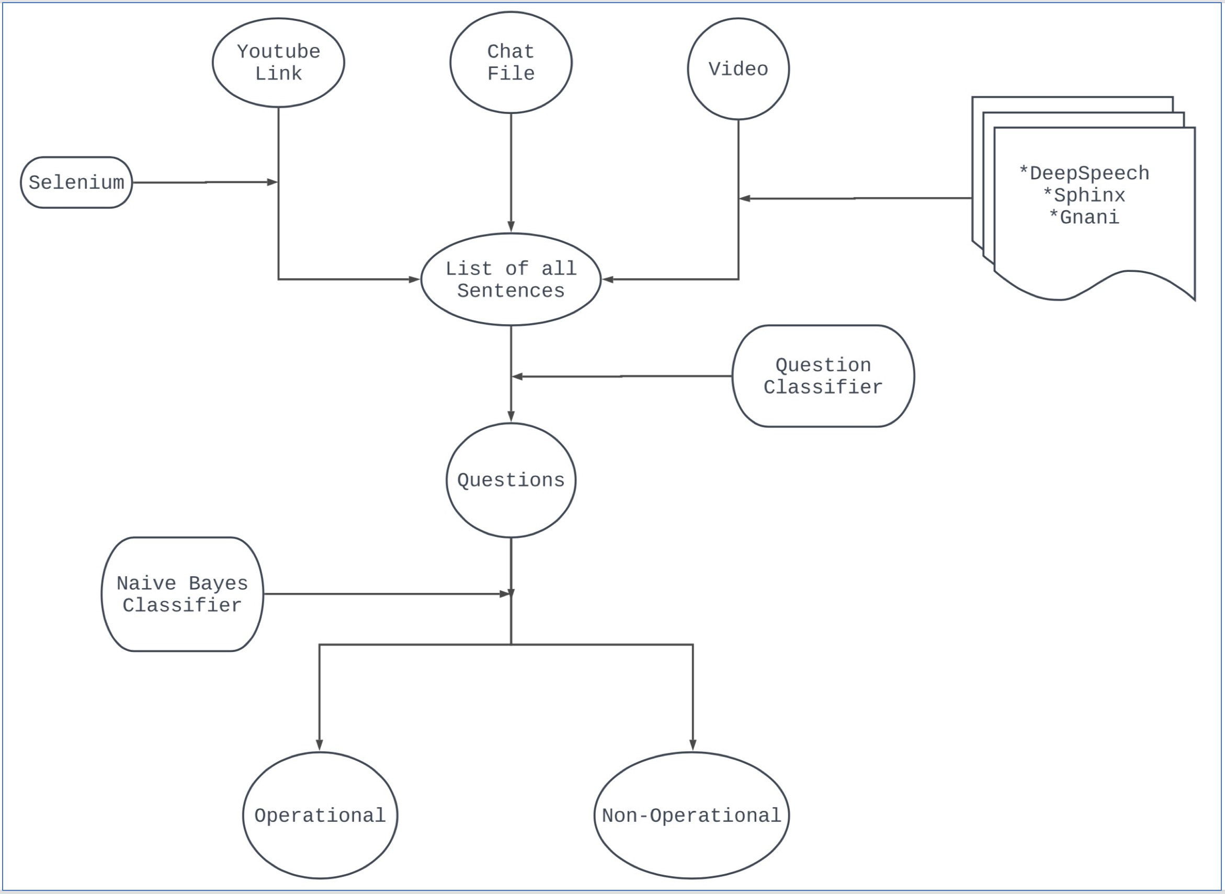
How are we doing this ?
Notes:
We have achieved this by building a pipeline.There are three inputs that are video,chat messages and youtube link. We have used Selenium to extract youtube chats from youtube link. Several softwares are tried to convert speech to text. Now, these list of sentences are passed thorugh a question classifier which extracts questions. Finally,Naive Bayes Classifier is used to predict the question whether it is operational or non-operational

Slide 6
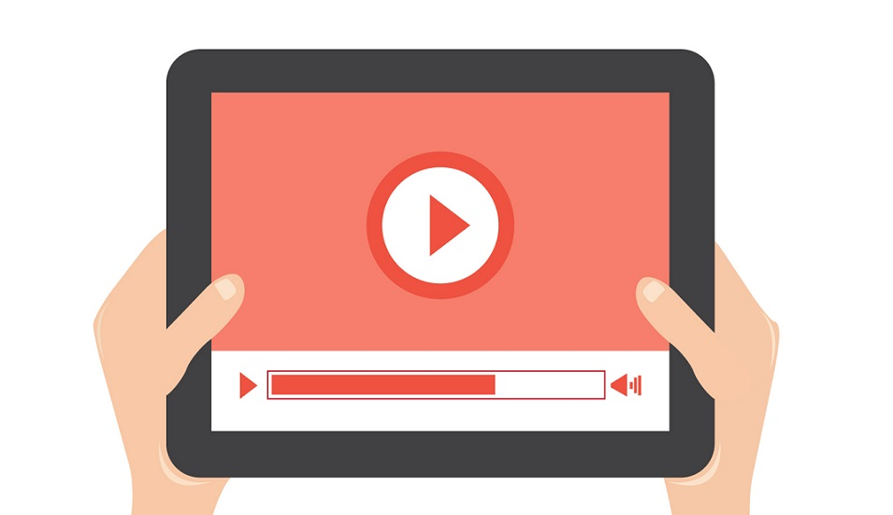
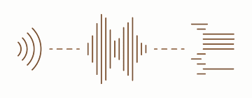
Video Transcript Extraction

Slide 7



Approach
Audio
Video
Transcript

Slide 8


Video-Audio Configuration
File Format: .wav
[Lossless and Uncompressed]
[frequency range (.wav) > .mp3]
Sampling Rate: 16000 Hz
Mono Channel
Technologies
Pydub
ffmpeg
youtube-dl

Slide 9
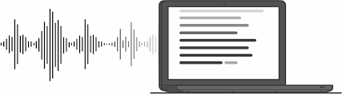
Speech to Text

Slide 10
Proprietary Services
Open Source Models
Google API for Speech Recognition
Gnani
CMU Sphinx
DeepSpeech

Slide 11
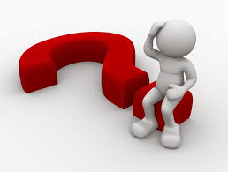
Problems!
Good speech-to-text conversion services are proprietary.
Free services aren’t accurate for Indian Accent.
Long length of videos is a major bottleneck (> 1 hr).

Slide 12
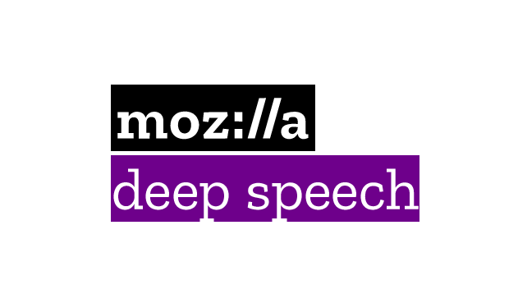
DeepSpeech to the rescue!

Slide 13



Why DeepSpeech?
Open Source
Pre-Trained Model available
Written in Python
Based on TensorFlow
Many branches available for separate functionalities
Huge Community Support (Mozilla Discourse)

Slide 14
Transfer Learning?
Transfer learning is a machine learning technique where a model trained on one task is re-purposed on a second related task.
Example:
E F

Slide 15
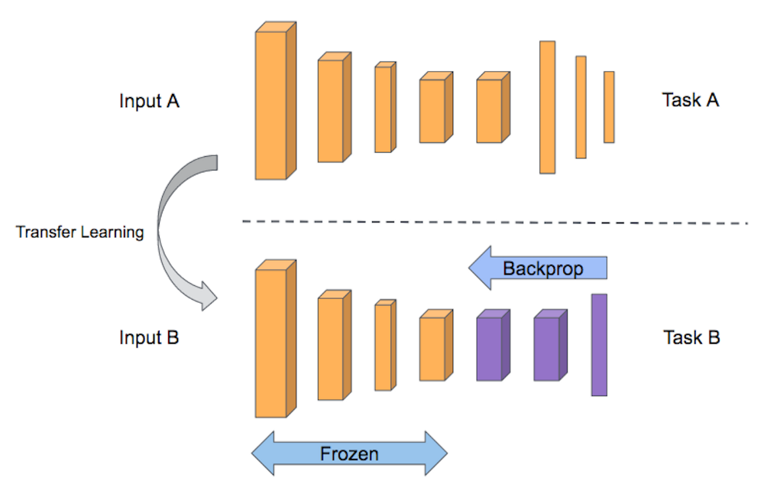
Training on DeepSpeech

Slide 16
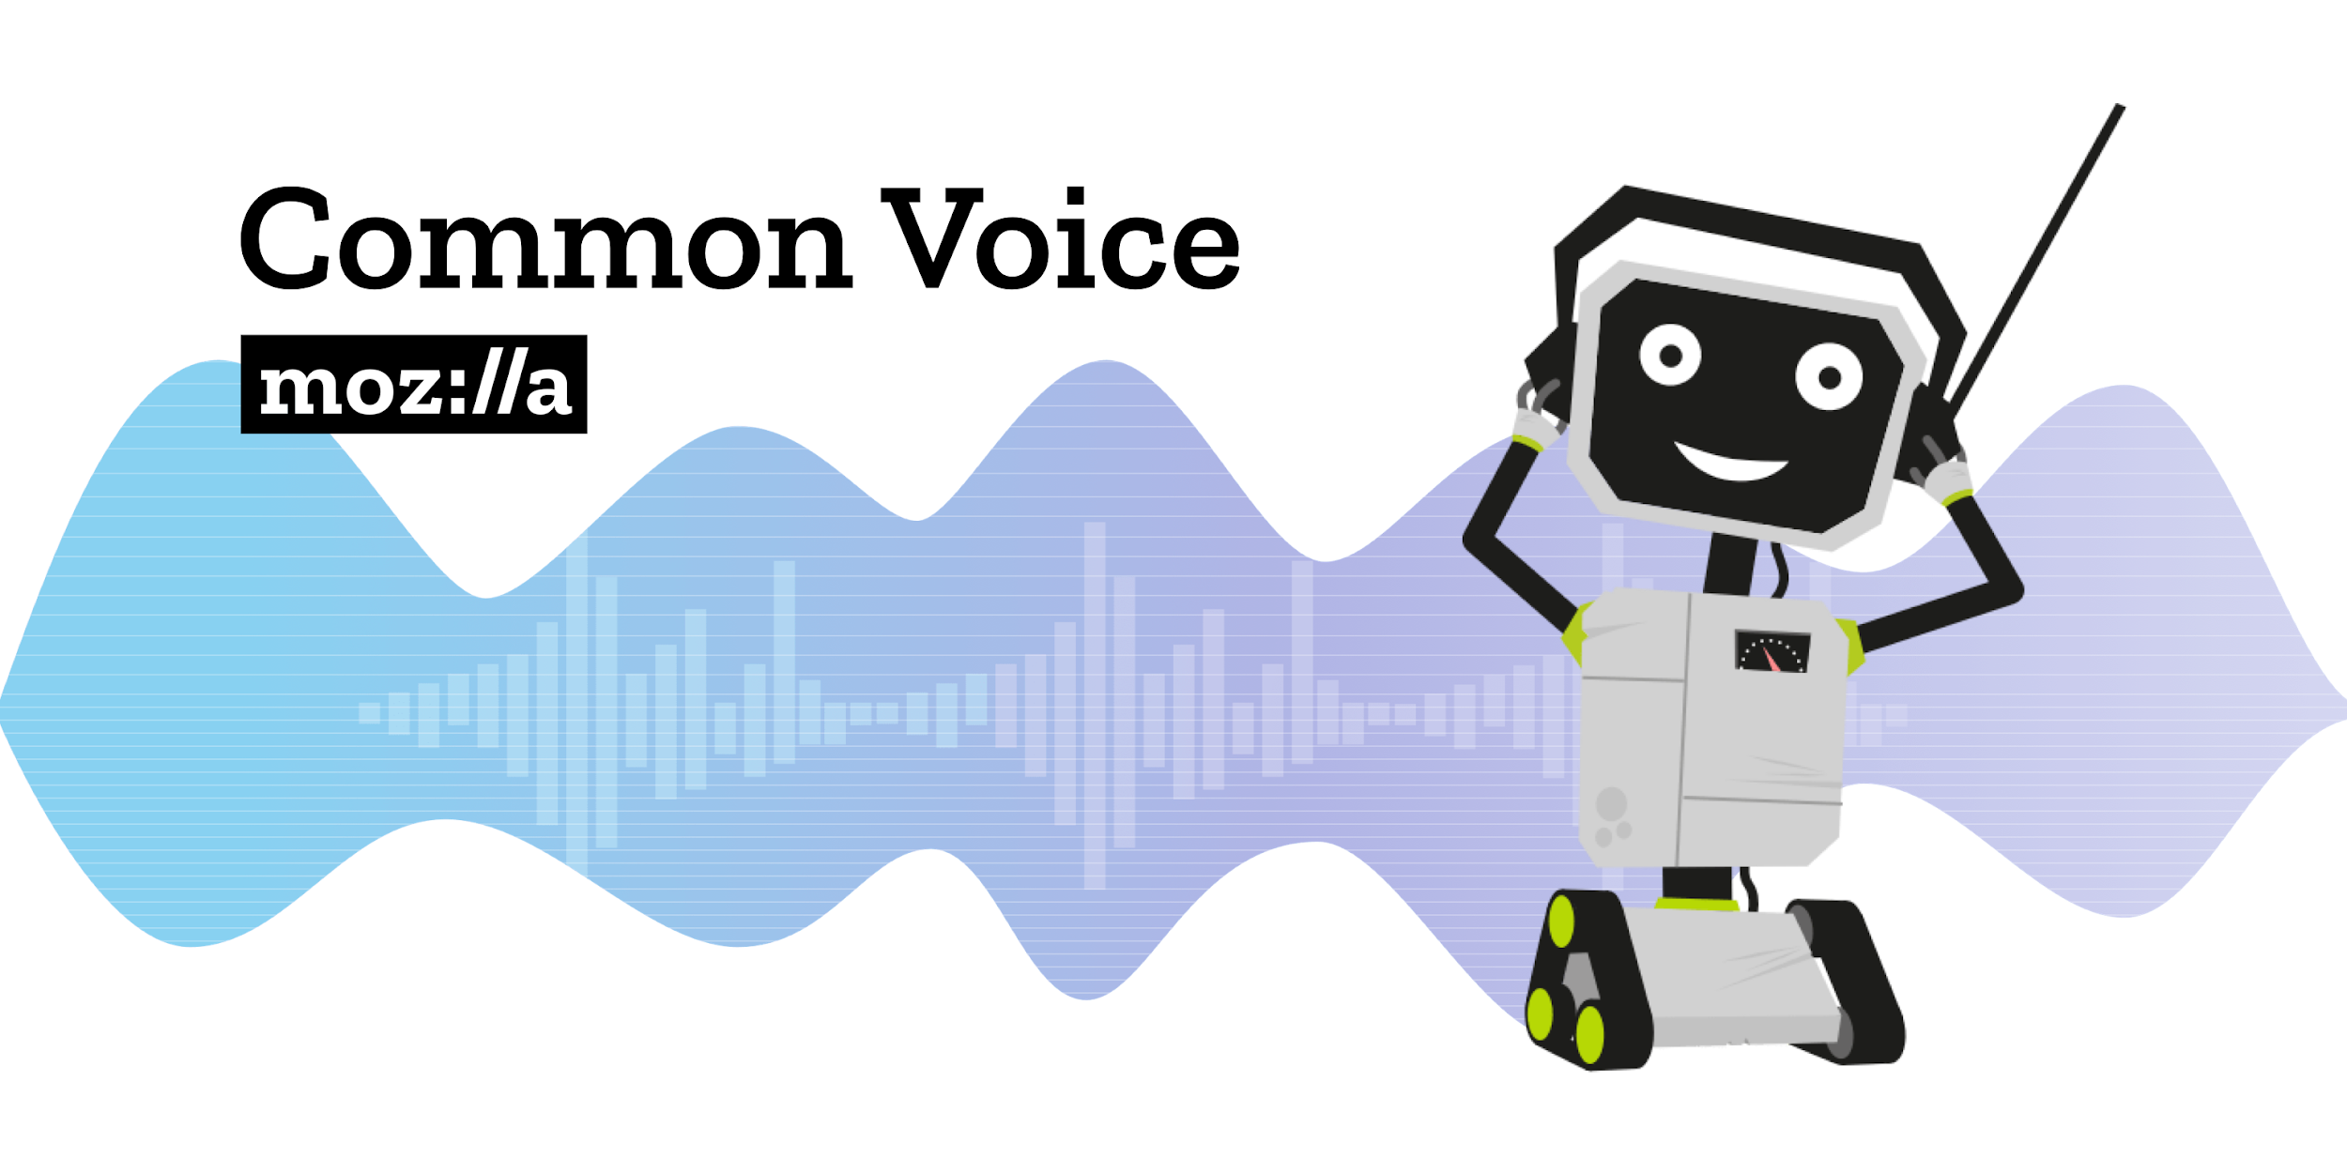
Getting the Data for Training

Slide 17
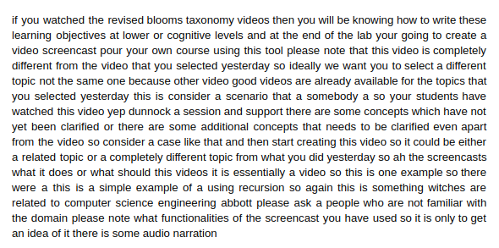
Sample Transcript
Problem with the Transcript?

Slide 18
DeepSegment
Uses advanced Natural Language Processing techniques to segregate sentences (Text Segmentation):
Global Vectors (GloVe)
seq2seq
GloVe + Bi-LSTM CRF

Slide 19

Selenium
Notes:
Videos were one of the data input for our pipeline...i.e., video. Our second second data input was youtube live chats. So how do we get those data. Simple go to the youtube copy every chat message and paste in your file. Isn’t it ? And that’s where selenium comes to rescue. So what is selenium ?

Slide 20

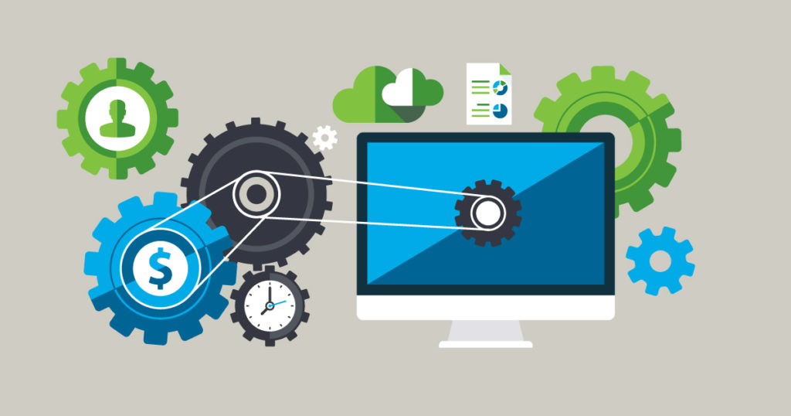

Tool
Selenium is primarily geared towards automated testing of web applications, but it is great as a general-purpose browser automation tool.
Selenium
Web Browser
Automate
Notes:
Selenium is a tool used to automate web browser. Primarily it was used to automate web browser testing but now a days people use it just to automate web browser.

Slide 21






Supporters : )
Notes:
Selenium have many programming language supporters just like Indian Cricket Team. So you can automate web browser using selenium in any of this language.

Slide 22
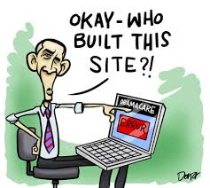
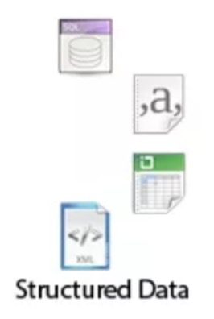
Static Web Scraping
automatically fetching the content of web pages
extracting some information.
Browser is not involved
Well, US government build that site !!
Notes:
Now let’s talk about different types of web scraping.The first one is Static web Scraping. All the website with articles are usually static. So using Selenium, we can download the whole webpage, including tags, images, text, everything on the webpage. Over here javascript and browser are not involved. There are other library which can do the static web scraping like beautifulsoup and scrapy. But what makes selenium different its competitors ?

Slide 23
What Makes It Great !

Slide 24



Dynamic Web Scraping
Online form filling
Scrape youtube comments
Play youtube videos automatically
Download millions of Medium blog articles
Download all the photos of an user on Instagram
And a lot more….
Notes:
The answer is Dynamic web scraping. When the word dynamic word comes into picture, along with it JavaScript and Browser also comes into picture. So using selenium you can…...yea but take precautions, check wheather scraping a particular website is legal or not. If its illegal then you have to spend some time in jail or pay money.
After hearing this, if you are planning something something evil to scrap someone’s personal data, then check it out whether it would be legal to scrap data from the website or not. If its illegal and you try to scrap and get caught, you might have to spend some time in jail or pay money. So take care about it.

Slide 25
Youtube
Live Chat Data
Scraping
Notes:
Now lets see where we have used selenium in our project. The whole process from starting youtube video to scraping relevant data. So once the script starts running, you can sit aside and slip some coffee.

Slide 26
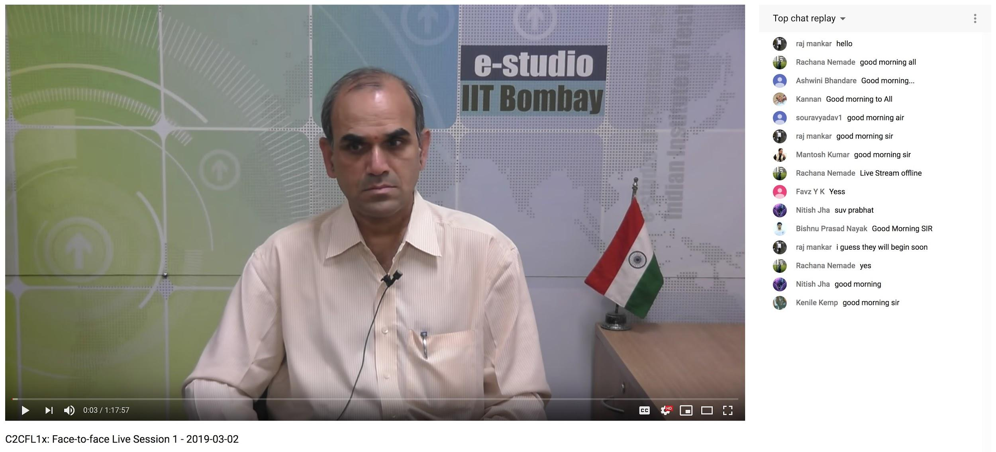

Video is started automatically using Selenium
Initially Live chats are not loaded at the start of the video
Notes:
So when the video starts, the live chats won’t appear. The video progress bar needs to be at the end to get all the live chats.

Slide 27
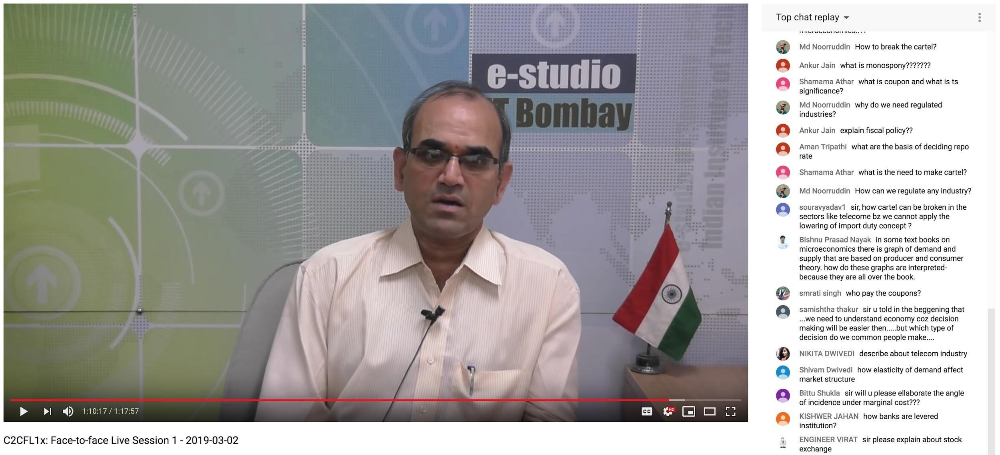
Move slider to the end of the video using Selenium
Notes:
So we move to the end of the video. The live chats are in different iframe. So we move from main iframe to the sub iframe and extract the page source. Then we just have to find where the chat is located in the parse tree and extract them.

Slide 28
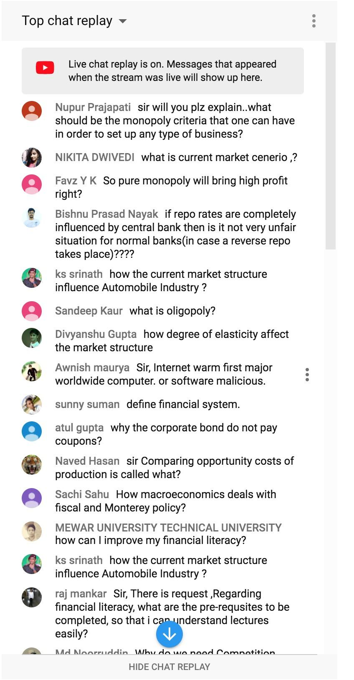
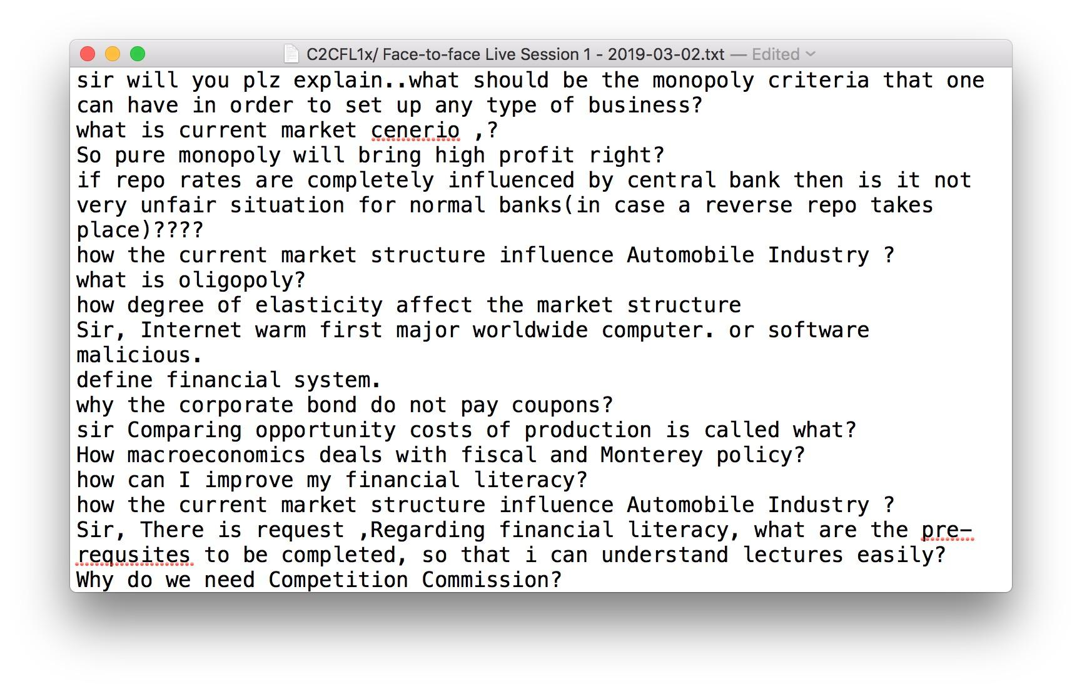
Result
Notes:
Here is the result. This is how we used selenium to extract YouTube live chat

Slide 29
Question Classifier
Notes:
So this is actually a recurrent neural network.

Slide 30
I don’t want to sit through a presentation after lunch!
Question Classifier
Probability : 0.05
Notes:
What does it do? Well, it takes a sentence and predicts the probability of that sentence being a question. Now the easiest way to go about it would be a question mark

Slide 31

Notes:
You have a question mark. The sentence is a question. But what if there is no question mark. That is the question to be addressed(pun intended)

Slide 32
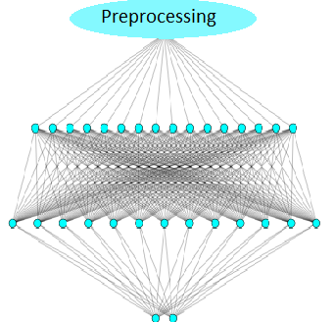
Sentence
Sentence
Question Classifier
Probability
Probability
Notes:
We use something called a neural network, specifically a recurrent neural network. Now, what is that? We will get to that in a minute. Here is what the question classifier if expanded would like . The sentence undergoes something called preprocessing and is passed through this wierd layers of balls and voila, you have the probability that the sentence is a question or not . We will go through what this quote preprocessing unquote and these layers of wierd balls mean one by one. Let’s start with pre-processing

Slide 33
The Processing done before processing!
Notes:
So, what we do in preprocessing is. Well first we take out those words which mean nothing to us. Like how you process sentences. You keep the important part and leave the rest . But we have to be carefull to not remove those words which might help in finding out if the given sentence is a question. Like wh words , question marks , etc.
. It’s called “pre” proccessing because that’s what you do before processing. See, such smart people!.

Slide 34
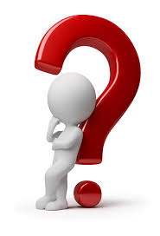
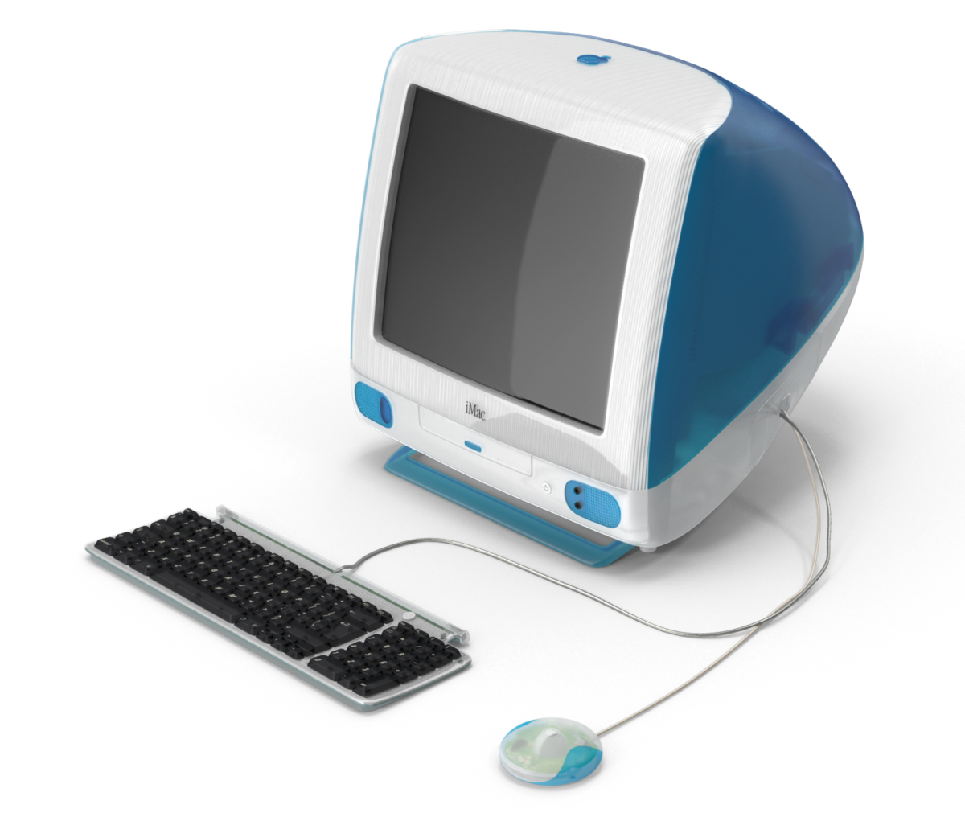

Sentence
1231231
Notes:
The initial problem is how will a computer process a sentence . If you would have given it a number , it can do wonders with it. How will it possibly understand what the sentence means!?

Slide 35
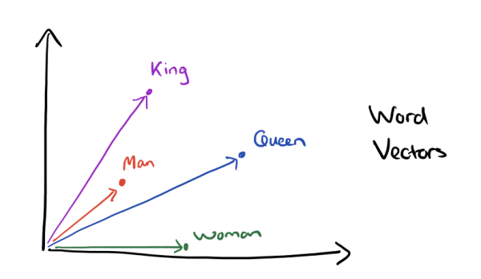
Glove Vectors
Notes:
This is what we do in layer 1. We convert this sentence into numbers in a very ingenious way. We use something called glove vectors. These are no way related to the kitchen mittens. These stand for Global vectors. Basically glove vectors map most of the common words in english to a vector space in which similar words have similar values. Now this image may be quite misleading because it is in 2 dimensional, the vector space we used was 100 dimensional. You start imagining that and heads will start literally exploding. But this vector space is so beautiful that an operation like king - man + woman will give you queen. Kudos to christopher manning and his team who developed this .

Slide 36
Notes:
Ok! Now coming to the second layer. This is the most significant part of the neural network.. This is the part which learns what a question is and what is not. I wont go in the details because of time constraints but what is basically does it , it iterates and learns over time if a sentence is a question or not. This analogy has been the standard, so i’ll state it here too. It’s how humans learn. You see an image you have never seen before, you guess what it is . This is a random guess. Then a friend tells you you are wrong and corrects you. You correct yourself. Now the next time you are asked, you have a better idea what the image is.

Slide 37
Notes:
Coming to this last neurons. These are there to convert our results into probabilities. The first neuron give you the probability of the sentence being a question and the other gives you the probability of a sentence not being a question. There you have it. The question classifier is complete.

Slide 38
Naive Bayes
Notes:
Ok! So we have our questions now. We have to segregate operational and non-operational queries.The problem is operational and non-operational queries are semantically not very different so we cannot use the recurrent neural network we used for question classifier. Also, The training data which we are using is small . Due to these reasons, we use a model called naive bayes. It is simple ,fast and reliable.
Naive bayes is a classification technique and uses probabilistic algorithms to predict the tag of a text.

Slide 39
IF it’s NAÏVE, why use it ?
Notes:
Now looking at the model’s name it says it’s naive. If the model is naive , why use it?! THe naive term is actually because of the simplicity of the algorithm’s technique. We assume that each word in a sentence is independent of other ones. .THink about it.Most of the sentences having the word “good” in them are positive sentences! And “bad” in them are negative sentences.

Slide 40
Types of Naive Bayes
Gaussian Naive Bayes:
Multinomial Naive Bayes:
Bernoulli Naive Bayes:
Notes:
There are three types of Naive Bayes : Gaussian ,Multinomial and Bernoulli.
Gaussian Naive Bayes is used for classification when the features used for predicting take a continuous value.
Multinomial Naive Bayes is used when predictors take discrete value .
They perform pretty well on text classification
The main feature used is frequency of words in the document.
Bernoulli is same as Multinomial but it uses Binary frequency instead of term frequency.

Slide 41

IMPLEMENTATION OF
NAIVE BAYES
Notes:
Now coming to the implementation of Naive Bayes.We have used Multinomial Naive Bayes

Slide 42
Input
The dataset consists of various ﬁelds which out of which only two columns are:
Sentences This column consists of sentences which can be questions or general messages.
Label
’N’: the sentence is not operational
’O’ sentence is operational.
Notes:
We have taken input in the form of a csv file contains 8-9 columns out of which only 2 are important :
Sentences :It contains chats of the students
Label:It contains the label corresponding to a sentence.
N for non-operational sentence and
O for operational sentence

Slide 43
Tfidf Transformer
CountVectorizer
Term-frequency times inverse document frequency
 |  |  |  | Pre Processing
Convert a collection of text documents to a matrix of token counts
Notes:
As Mayank has already explained the importance of Pre Processing ,I would like to use that analogy in Naive Bayes .
We pass the sentences through Count Vectorizer which tokenizes them and converts the corpus into a more manageable form.
The goal of using tf-idf is to scale down the impact of tokens that occur very frequently in a given corpus and that are hence empirically less informative than features that oThen the sentences are passed through TF-IDF tRANSFORMER which stands for ( Term-frequency times inverse document frequency).ccur in a small fraction of the training corpus.

Slide 44

Result:
SAMPLE INPUT | OUTPUT
How to determine symptoms of fever | Non Operational
Am I visible? | Operational
Notes:
Since now we know how naive bayes works and we will see how it classifies sentences as operational and non operational.

Slide 45

Accuracy
The accuracy of this model is 86%

Slide 46
Future Work
DeepSpeech can be pre-trained with large amount of data to give better results on Indian accent.
Which remote centers need equipment maintenance.
Log and Chat files must be saved instead of being overwritten, so that ample data is available for analysis.
Notes:
We can train deep speech model on more Indian accent data to get better results
And we can also find which remote centres need more equipment maintenance by seeing the number of operational queries asked in that centre.
In A-View system log and chat files were overwritten ,in future if they are saved instead of being overwritten this pipeline can be used for better analysis .

Slide 47
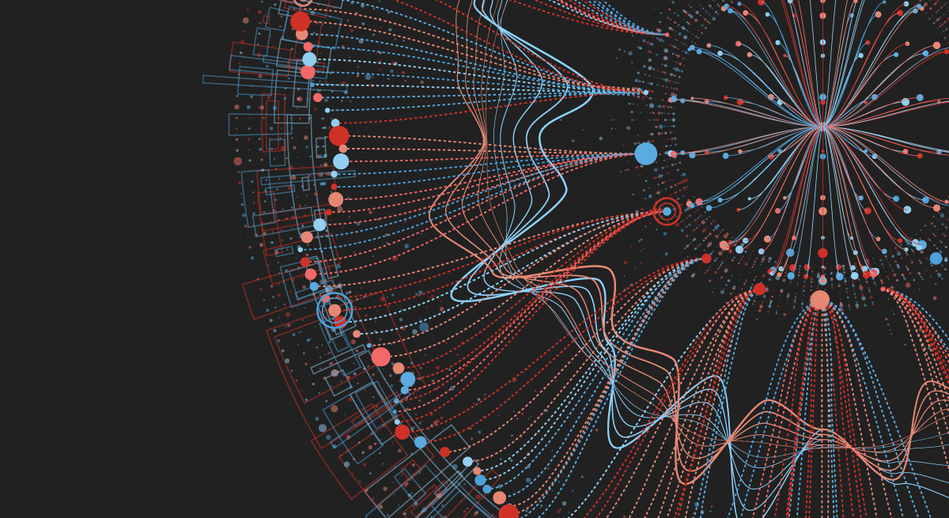
Demo

Slide 48
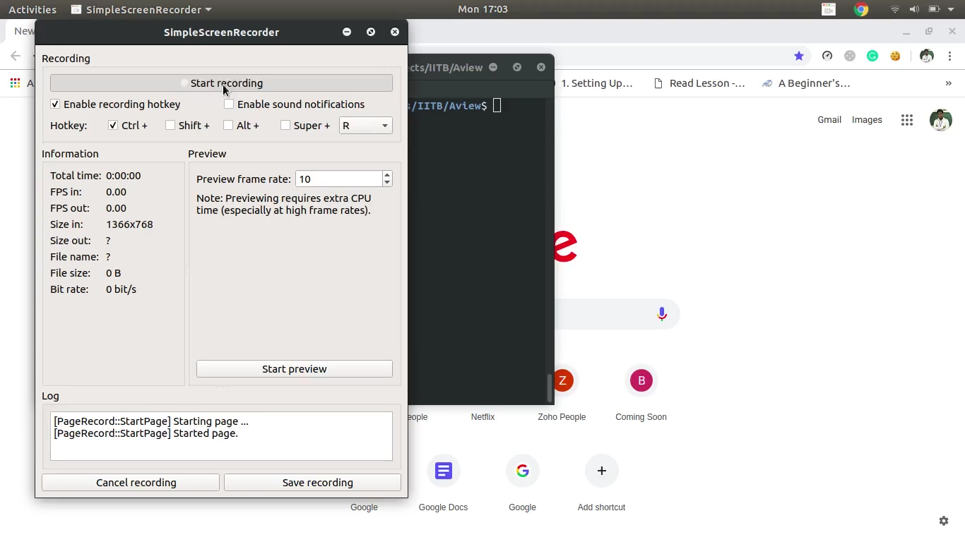

Slide 49


Thank
you

